Slide 1
Digital Portfolio
STUDENT NAME:v.Durga devi
REGISTER NO AND NMID: astvu21021024u18022
DEPARTMENT: B sc computer science
COLLEGE: Sri Akilandeswari womenwomen's college -wandiwash

Slide 2
DIGITAL PORTFOLIO

Slide 3


AGENDA
Problem Statement
Project Overview
End Users
Tools and Technologies
Portfolio design and Layout
Features and Functionality
Results and Screenshots
Conclusion
Github Link
3/21/2024 Annual Review

Slide 4

PROBLEM STATEMENT
create a personal portfolio website to showcase skills, experience, and achievements.
Code Explanation
The code uses HTML, CSS, and JavaScript to build a responsive website with:
1. *Smooth Scrolling*: Navigation links scroll smoothly to sections.
2. *Form Validation*: User input is validated for correctness.
3. *Responsive Design*: Website adapts to different screen sizes.
The code provides a foundation for a professional online presence.

Slide 5

PROJECT OVERVIEW
A personal portfolio website to showcase skills, experience, and achievements.
Key Features
1. Responsive design
2. Smooth scrolling
3. Form validation
Goals
1. Showcase skills and experience
2. Improve online visibility
3. Enhance user experience
Technologies
1. HTML
2. CSS
3. JavaScript
Benefits
1. Professional online presence
2. Increased opportunities

Slide 6

WHO ARE THE END USERS?
End Users - Potential Employers - Clients - Collaborators - Industry Peers They seek to learn about individual's skills, experience, and services, and to establish professional connections.

Slide 7

TOOLS AND TECHNIQUES
*HTML*: Structure and content
*CSS*: Styling and layout
*JavaScript*: Interactivity and dynamic effects
These technologies work together to create a responsive, user-friendly, and visually appealing personal portfolio website.

Slide 8
POTFOLIO DESIGN AND LAYOUT
*Responsive Design*: Adapts to different screen sizes and devices
*Clean and Modern*: Visually appealing and easy to navigate
*Sections*: Includes Home, About, Projects, Contact, and other relevant sections
*Typography*: Clear and readable font styles and sizes
*Color Scheme*: Consistent and professional color palette
These design elements work together to create a professional and engaging online portfolio.
8

Slide 9
FEATURES AND FUNCTIONALITY
*Smooth Scrolling*: Seamless navigation between sections
*Form Validation*: Ensures accurate user input
*Responsive Design*: Adapts to different devices and screen sizes
*Easy Navigation*: Intuitive menu and clear calls-to-action
*Project Showcase*: Displays projects with images, descriptions, and links
These features enhance user experience, showcase individual's work, and provide a professional online presence.

Slide 10
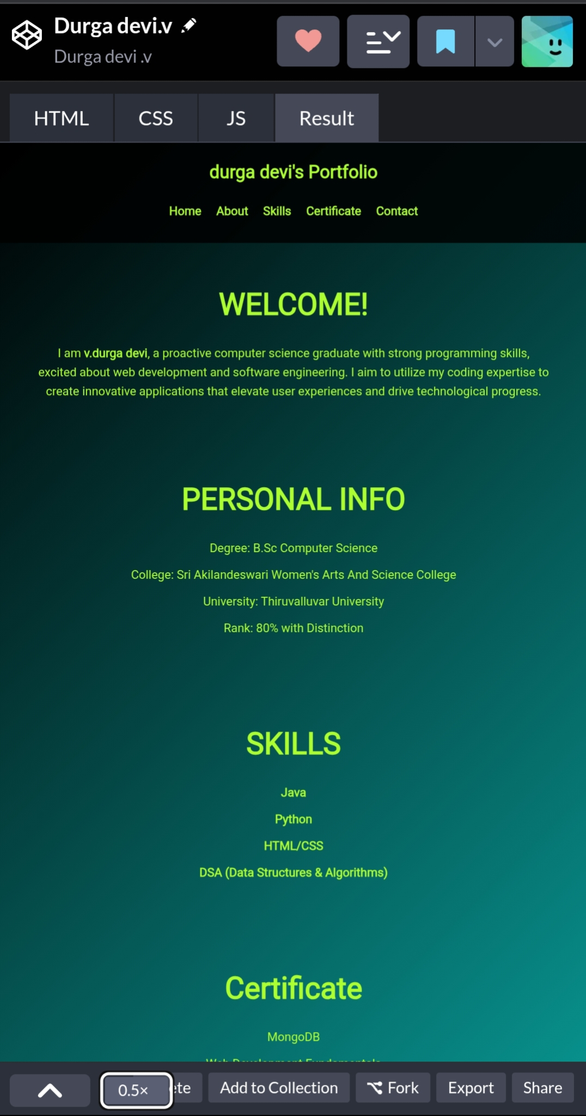

RESULTS AND SCREENSHOTS
3/21/2024 Annual Review
10

Slide 11
CONCLUSION
The personal portfolio website is a powerful tool for showcasing skills, experience, and achievements, providing a professional online presence, and opening doors to new opportunities.
It effectively:
- Demonstrates expertise and accomplishments
- Enhances online visibility and credibility
- Facilitates connections and collaborations
By maintaining and updating the website, individuals can continue to grow their professional network and advance their careers.
11

